Slide 1
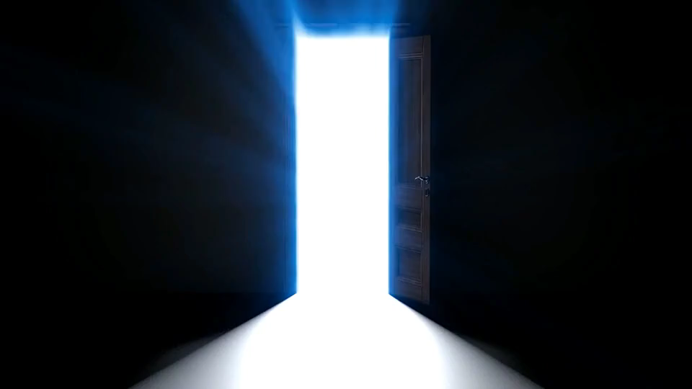
目標
Notes:
https://pixabay.com/videos/door-squeak-door-opening-6714/

Slide 2

阻礙
Notes:
https://pixabay.com/videos/colorful-percussion-instrument-55762/

Slide 3

努力
Notes:
https://pixabay.com/videos/tunnel-corridor-lights-abstract-79765/

Slide 4

結果
Notes:
https://pixabay.com/videos/pipes-neon-visual-vj-vj-loop-127073/

Slide 5

意外
Notes:
https://pixabay.com/videos/mosaic-tile-pattern-design-texture-121275/

Slide 6

轉彎
Notes:
https://pixabay.com/videos/overlay-water-element-composite-15794/

Slide 7
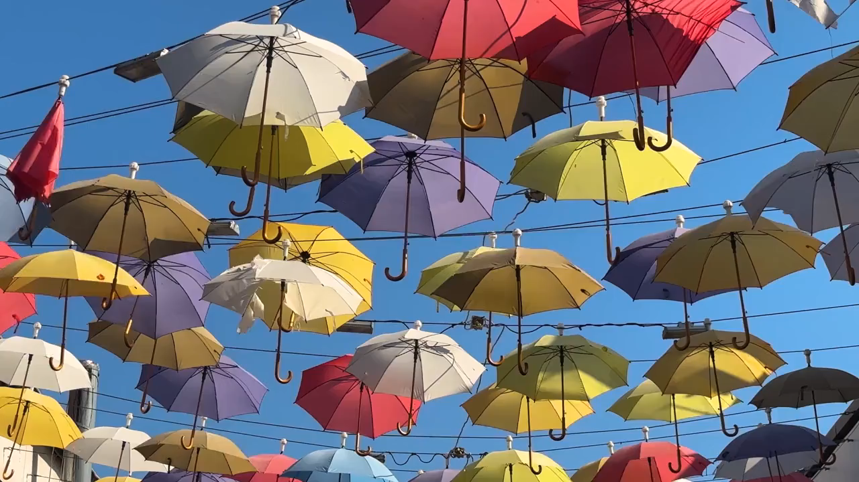
結果
Notes:
https://pixabay.com/videos/umbrellas-decor-street-hanging-232396/

